Slide 1




SRM INSTITUTE OF SCIENCE AND TECHNOLOGY,
CHENNAI.
18CSC205J-Operating Systems
Unit- II

Slide 2
UNIT II SYLLABUS
Process Synchronization - Peterson’s solution, Synchronization Hardware - Understanding the two-process solution and the benefits of the synchronization hardware - Process synchronization: Semaphores, usage, implementation - Gaining the knowledge of the usage of the semaphores for the Mutual exclusion Mechanisms - Classical Problems of synchronization - Readers writers problem, Bounded Buffer problem - Good understanding of synchronization Mechanisms - Classical Problems of synchronization - Dining Philosophers problem (Monitor) - Understanding the synchronization of limited resources among multiple processes
CPU SCHEDULING : FCFS,SJF,Priority - Understanding the scheduling techniques - CPU Scheduling: Round robin, Multilevel queue Scheduling, Multilevel feedback Scheduling -Understanding the scheduling techniques - Real Time scheduling: Rate Monotonic Scheduling and Deadline Scheduling - Understanding the real time scheduling
DEADLOCKS: Necessary conditions, Resource allocation graph, Deadlock prevention methods - Understanding the deadlock scenario - Deadlocks :Deadlock Avoidance, Detection and Recovery - Understanding the deadlock avoidance, detection and recovery mechanisms

Slide 3
Process Synchronization
Background
The Critical-Section Problem
Peterson’s Solution
Synchronization Hardware
Mutex Locks
Semaphores
Classic Problems of Synchronization
Monitors

Slide 4
Background
Processes can execute concurrently
May be interrupted at any time, partially completing execution
Concurrent access to shared data may result in data inconsistency
Maintaining data consistency requires mechanisms to ensure the orderly execution of cooperating processes
Illustration of the problem: Suppose that we wanted to provide a solution to the consumer-producer problem that fills all the buffers. We can do so by having an integer counter that keeps track of the number of full buffers. Initially, counter is set to 0. It is incremented by the producer after it produces a new buffer and is decremented by the consumer after it consumes a buffer.

Slide 5
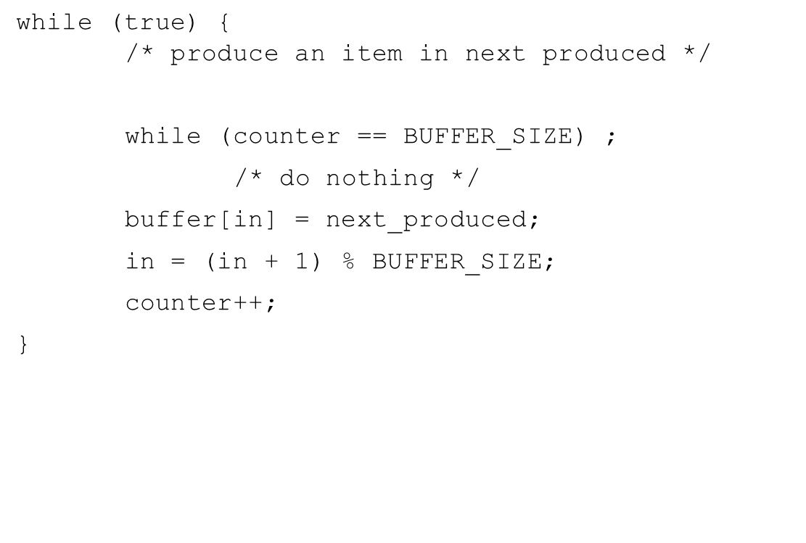
Producer
while (true) { /* produce an item in next produced */
while (counter == BUFFER_SIZE) ;
/* do nothing */
buffer[in] = next_produced;
in = (in + 1) % BUFFER_SIZE;
counter++;
}

Slide 6
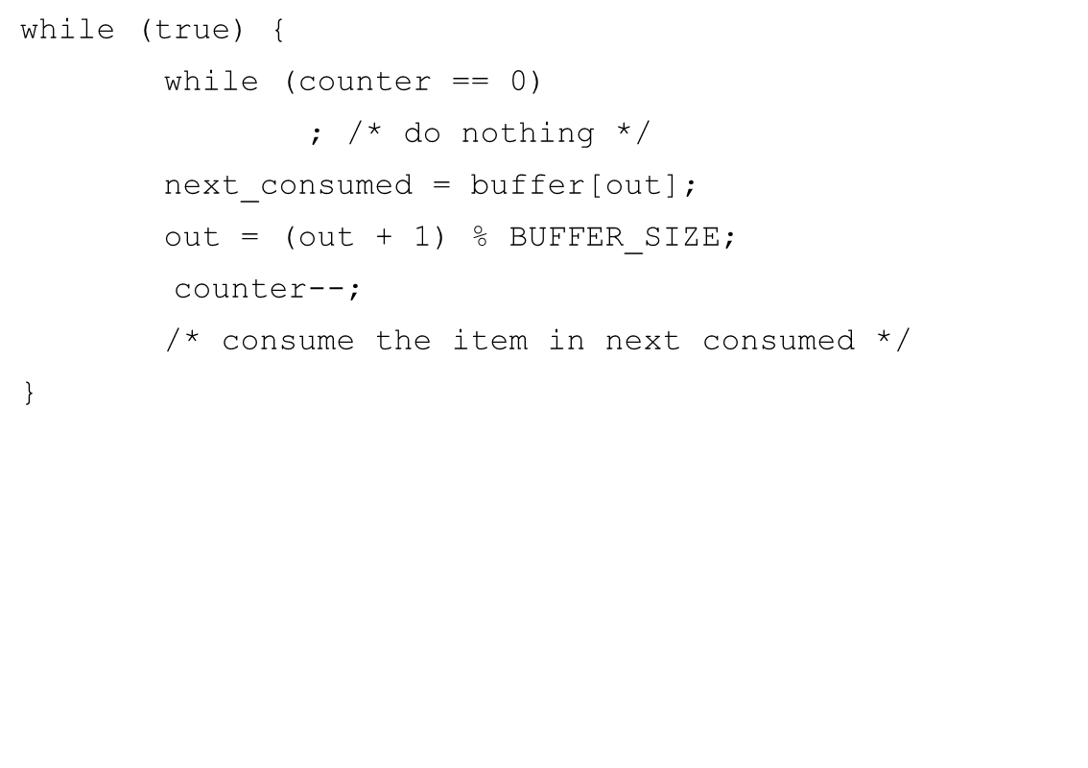
Consumer

Slide 7
Race Condition
counter++ could be implemented as register1 = counter register1 = register1 + 1 counter = register1
counter-- could be implemented as register2 = counter register2 = register2 - 1 counter = register2
Consider this execution interleaving with “count = 5” initially:
S0: producer execute register1 = counter {register1 = 5} S1: producer execute register1 = register1 + 1 {register1 = 6} S2: consumer execute register2 = counter {register2 = 5} S3: consumer execute register2 = register2 – 1 {register2 = 4} S4: producer execute counter = register1 {counter = 6 } S5: consumer execute counter = register2 {counter = 4}

Slide 8
Critical Section Problem
Consider system of n processes {p₀, p₁, … p_{n-1}}
Each process has critical section segment of code
Process may be changing common variables, updating table, writing file, etc
When one process in critical section, no other may be in its critical section
Critical section problem is to design protocol to solve this
Each process must ask permission to enter critical section in entry section, may follow critical section with exit section, then remainder section

Slide 9
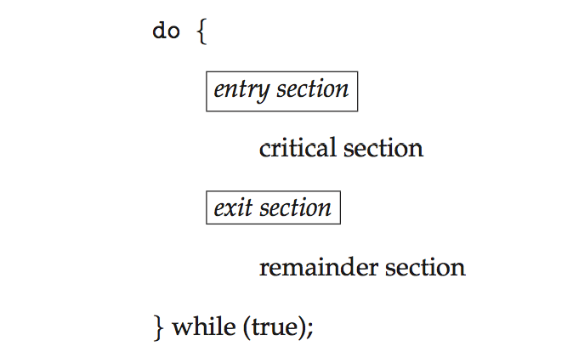
Critical Section
General structure of process P_{i}

Slide 10
Algorithm for Process P_{i}
do {
while (turn == j);
critical section
turn = j;
remainder section
} while (true);

Slide 11
Solution to Critical-Section Problem
1. Mutual Exclusion - If process P_{i} is executing in its critical section, then no other processes can be executing in their critical sections
2. Progress - If no process is executing in its critical section and there exist some processes that wish to enter their critical section, then the selection of the processes that will enter the critical section next cannot be postponed indefinitely
3. Bounded Waiting - A bound must exist on the number of times that other processes are allowed to enter their critical sections after a process has made a request to enter its critical section and before that request is granted
Assume that each process executes at a nonzero speed
No assumption concerning relative speed of the n processes

Slide 12
Critical-Section Handling in OS
Two approaches depending on if kernel is preemptive or non- preemptive
Preemptive – allows preemption of process when running in kernel mode
Non-preemptive – runs until exits kernel mode, blocks, or voluntarily yields CPU
Essentially free of race conditions in kernel mode

Slide 13
Peterson’s Solution
Good algorithmic description of solving the problem
Two process solution
Assume that the load and store machine-language instructions are atomic; that is, cannot be interrupted
The two processes share two variables:
int turn;
Boolean flag[2]
The variable turn indicates whose turn it is to enter the critical section
The flag array is used to indicate if a process is ready to enter the critical section. flag[i] = true implies that process P_{i} is ready!

Slide 14
Algorithm for Process P_{i}
do {
flag[i] = true;
turn = j;
while (flag[j] && turn = = j);
critical section
flag[i] = false;
remainder section
} while (true);

Slide 15
Peterson’s Solution (Cont.)
Provable that the three CS requirement are met:
1. Mutual exclusion is preserved
P_{i} enters CS only if:
either flag[j] = false or turn = i
2. Progress requirement is satisfied
3. Bounded-waiting requirement is met

Slide 16
Synchronization Hardware
Many systems provide hardware support for implementing the critical section code.
All solutions below based on idea of locking
Protecting critical regions via locks
Uniprocessors – could disable interrupts
Currently running code would execute without preemption
Generally too inefficient on multiprocessor systems
Operating systems using this not broadly scalable
Modern machines provide special atomic hardware instructions
Atomic = non-interruptible
Either test memory word and set value
Or swap contents of two memory words

Slide 17
Solution to Critical-section Problem Using Locks
do {
acquire lock
critical section
release lock
remainder section
} while (TRUE);

Slide 18
test_and_set Instruction
Definition:
boolean test_and_set (boolean *target)
{
boolean rv = *target;
*target = TRUE;
return rv:
}
Executed atomically
Returns the original value of passed parameter
Set the new value of passed parameter to “TRUE”.

Slide 19
Solution using test_and_set()
Shared Boolean variable lock, initialized to FALSE
Solution:
do { while (test_and_set(&lock))
; /* do nothing */
/* critical section */
lock = false;
/* remainder section */
} while (true);

Slide 20
compare_and_swap Instruction
Definition:
int compare _and_swap(int *value, int expected, int new_value) {
int temp = *value;
if (*value == expected)
*value = new_value;
return temp;
}
Executed atomically
Returns the original value of passed parameter “value”
Set the variable “value” the value of the passed parameter “new_value” but only if “value” ==“expected”. That is, the swap takes place only under this condition.

Slide 21
Solution using compare_and_swap
Shared integer “lock” initialized to 0;
Solution:
do { while (compare_and_swap(&lock, 0, 1) != 0)
; /* do nothing */
/* critical section */
lock = 0;
/* remainder section */
} while (true);

Slide 22
Bounded-waiting Mutual Exclusion with test_and_set
do { waiting[i] = true; key = true; while (waiting[i] && key)
key = test_and_set(&lock);
waiting[i] = false;
/* critical section */
j = (i + 1) % n;
while ((j != i) && !waiting[j])
j = (j + 1) % n;
if (j == i)
lock = false;
else
waiting[j] = false;
/* remainder section */
} while (true);

Slide 23
Mutex Locks
Previous solutions are complicated and generally inaccessible to application programmers
OS designers build software tools to solve critical section problem
Simplest is mutex lock
Protect a critical section by first acquire() a lock then release() the lock
Boolean variable indicating if lock is available or not
Calls to acquire() and release() must be atomic
Usually implemented via hardware atomic instructions
But this solution requires busy waiting
This lock therefore called a spinlock

Slide 24
acquire() and release()
acquire() { while (!available)
; /* busy wait */
available = false;
}
release() {
available = true;
}
do {
acquire lock
critical section
release lock
remainder section
} while (true);

Slide 25
Semaphore
Synchronization tool that provides more sophisticated ways (than Mutex locks) for process to synchronize their activities.
Semaphore S – integer variable
Can only be accessed via two indivisible (atomic) operations
wait() and signal()
Originally called P() and V()
Definition of the wait() operation
wait(S) {
while (S <= 0)
; // busy wait
S--;
}
Definition of the signal() operation
signal(S) {
S++;
}

Slide 26
Semaphore Usage
Counting semaphore – integer value can range over an unrestricted domain
Binary semaphore – integer value can range only between 0 and 1
Same as a mutex lock
Can solve various synchronization problems
Consider P₁ and P₂ that require S₁ to happen before S₂
Create a semaphore “synch” initialized to 0
P1:
S₁;
signal(synch);
P2:
wait(synch);
S₂;
Can implement a counting semaphore S as a binary semaphore

Slide 27
Semaphore Implementation
Must guarantee that no two processes can execute the wait() and signal() on the same semaphore at the same time
Thus, the implementation becomes the critical section problem where the wait and signal code are placed in the critical section
Could now have busy waiting in critical section implementation
But implementation code is short
Little busy waiting if critical section rarely occupied
Note that applications may spend lots of time in critical sections and therefore this is not a good solution

Slide 28
Semaphore Implementation with no Busy waiting
With each semaphore there is an associated waiting queue
Each entry in a waiting queue has two data items:
value (of type integer)
pointer to next record in the list
Two operations:
block – place the process invoking the operation on the appropriate waiting queue
wakeup – remove one of processes in the waiting queue and place it in the ready queue
typedef struct{
int value;
struct process *list;
} semaphore;

Slide 29
Implementation with no Busy waiting (Cont.)
wait(semaphore *S) {
S->value--;
if (S->value < 0) { add this process to S->list;
block();
}
}
signal(semaphore *S) {
S->value++;
if (S->value <= 0) { remove a process P from S->list;
wakeup(P);
}
}

Slide 30
Deadlock and Starvation
Deadlock – two or more processes are waiting indefinitely for an event that can be caused by only one of the waiting processes
Let S and Q be two semaphores initialized to 1
P₀ P₁
wait(S); wait(Q);
wait(Q); wait(S);
... ...
signal(S); signal(Q);
signal(Q); signal(S);
Starvation – indefinite blocking
A process may never be removed from the semaphore queue in which it is suspended
Priority Inversion – Scheduling problem when lower-priority process holds a lock needed by higher-priority process
Solved via priority-inheritance protocol

Slide 31
Classical Problems of Synchronization
Classical problems used to test newly-proposed synchronization schemes
Bounded-Buffer Problem
Readers and Writers Problem
Dining-Philosophers Problem

Slide 32
Bounded-Buffer Problem
n buffers, each can hold one item
Semaphore mutex initialized to the value 1
Semaphore full initialized to the value 0
Semaphore empty initialized to the value n

Slide 33
Bounded Buffer Problem (Cont.)
The structure of the producer process
do {
... /* produce an item in next_produced */
...
wait(empty);
wait(mutex);
... /* add next produced to the buffer */
...
signal(mutex);
signal(full);
} while (true);

Slide 34
Bounded Buffer Problem (Cont.)
The structure of the consumer process
Do {
wait(full);
wait(mutex);
... /* remove an item from buffer to next_consumed */
...
signal(mutex);
signal(empty);
... /* consume the item in next consumed */
... } while (true);

Slide 35
Readers-Writers Problem
A data set is shared among a number of concurrent processes
Readers – only read the data set; they do not perform any updates
Writers – can both read and write
Problem – allow multiple readers to read at the same time
Only one single writer can access the shared data at the same time
Several variations of how readers and writers are considered – all involve some form of priorities
Shared Data
Data set
Semaphore rw_mutex initialized to 1
Semaphore mutex initialized to 1
Integer read_count initialized to 0

Slide 36
Readers-Writers Problem (Cont.)
The structure of a writer process
do { wait(rw_mutex);
... /* writing is performed */
...
signal(rw_mutex);
} while (true);

Slide 37
Readers-Writers Problem (Cont.)
The structure of a reader process
do { wait(mutex); read_count++; if (read_count == 1)
wait(rw_mutex);
signal(mutex);
... /* reading is performed */
...
wait(mutex); read count--; if (read_count == 0)
signal(rw_mutex);
signal(mutex);
} while (true);

Slide 38
Readers-Writers Problem Variations
First variation – no reader kept waiting unless writer has permission to use shared object
Second variation – once writer is ready, it performs the write ASAP
Both may have starvation leading to even more variations
Problem is solved on some systems by kernel providing reader-writer locks

Slide 39

Dining-Philosophers Problem
Philosophers spend their lives alternating thinking and eating
Don’t interact with their neighbors, occasionally try to pick up 2 chopsticks (one at a time) to eat from bowl
Need both to eat, then release both when done
In the case of 5 philosophers
Shared data
Bowl of rice (data set)
Semaphore chopstick [5] initialized to 1

Slide 40
Dining-Philosophers Problem Algorithm
The structure of Philosopher i:
do {
wait (chopstick[i] );
wait (chopStick[ (i + 1) % 5] );
// eat
signal (chopstick[i] );
signal (chopstick[ (i + 1) % 5] );
// think
} while (TRUE);
What is the problem with this algorithm?

Slide 41
Dining-Philosophers Problem Algorithm (Cont.)
Deadlock handling
Allow at most 4 philosophers to be sitting simultaneously at the table.
Allow a philosopher to pick up the forks only if both are available (picking must be done in a critical section.
Use an asymmetric solution -- an odd-numbered philosopher picks up first the left chopstick and then the right chopstick. Even-numbered philosopher picks up first the right chopstick and then the left chopstick.

Slide 42
Problems with Semaphores
Incorrect use of semaphore operations:
signal (mutex) …. wait (mutex)
wait (mutex) … wait (mutex)
Omitting of wait (mutex) or signal (mutex) (or both)
Deadlock and starvation are possible.

Slide 43
Monitors
A high-level abstraction that provides a convenient and effective mechanism for process synchronization
Abstract data type, internal variables only accessible by code within the procedure
Only one process may be active within the monitor at a time
But not powerful enough to model some synchronization schemes
monitor monitor-name
{
// shared variable declarations
procedure P1 (…) { …. }
procedure Pn (…) {……}
Initialization code (…) { … }
}
}

Slide 44
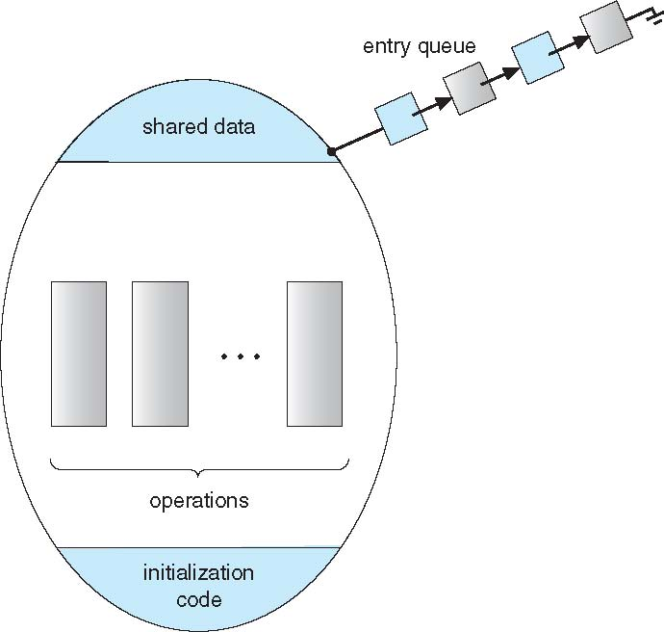
Schematic view of a Monitor

Slide 45
Condition Variables
condition x, y;
Two operations are allowed on a condition variable:
x.wait() – a process that invokes the operation is suspended until x.signal()
x.signal() – resumes one of processes (if any) that invoked x.wait()
If no x.wait() on the variable, then it has no effect on the variable

Slide 46
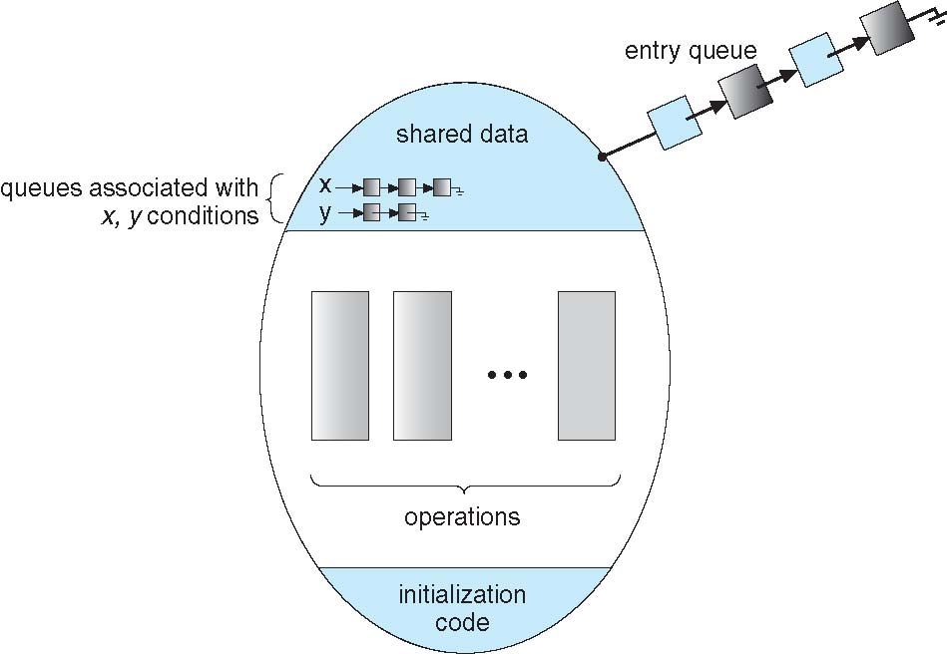
Monitor with Condition Variables

Slide 47
Condition Variables Choices
If process P invokes x.signal(), and process Q is suspended in x.wait(), what should happen next?
Both Q and P cannot execute in paralel. If Q is resumed, then P must wait
Options include
Signal and wait – P waits until Q either leaves the monitor or it waits for another condition
Signal and continue – Q waits until P either leaves the monitor or it waits for another condition
Both have pros and cons – language implementer can decide
Monitors implemented in Concurrent Pascal compromise
P executing signal immediately leaves the monitor, Q is resumed
Implemented in other languages including Mesa, C#, Java

Slide 48
Monitor Solution to Dining Philosophers
monitor DiningPhilosophers
{
enum { THINKING; HUNGRY, EATING) state [5] ;
condition self [5];
void pickup (int i) {
state[i] = HUNGRY;
test(i);
if (state[i] != EATING) self[i].wait;
}
void putdown (int i) {
state[i] = THINKING;
// test left and right neighbors
test((i + 4) % 5);
test((i + 1) % 5);
}

Slide 49
Solution to Dining Philosophers (Cont.)
void test (int i) {
if ((state[(i + 4) % 5] != EATING) &&
(state[i] == HUNGRY) &&
(state[(i + 1) % 5] != EATING) ) {
state[i] = EATING ;
self[i].signal () ;
}
}
initialization_code() {
for (int i = 0; i < 5; i++)
state[i] = THINKING;
}
}

Slide 50
Solution to Dining Philosophers (Cont.)
Each philosopher i invokes the operations pickup() and putdown() in the following sequence:
DiningPhilosophers.pickup(i);
EAT
DiningPhilosophers.putdown(i);
No deadlock, but starvation is possible

Slide 51
Monitor Implementation Using Semaphores
Variables
semaphore mutex; // (initially = 1)
semaphore next; // (initially = 0)
int next_count = 0;
Each procedure F will be replaced by
wait(mutex);
…
body of F;
…
if (next_count > 0)
signal(next)
else
signal(mutex);
Mutual exclusion within a monitor is ensured

Slide 52
Monitor Implementation – Condition Variables
For each condition variable x, we have:
semaphore x_sem; // (initially = 0)
int x_count = 0;
The operation x.wait can be implemented as:
x_count++;
if (next_count > 0)
signal(next);
else
signal(mutex);
wait(x_sem);
x_count--;

Slide 53
Monitor Implementation (Cont.)
The operation x.signal can be implemented as:
if (x_count > 0) {
next_count++;
signal(x_sem);
wait(next);
next_count--;
}

Slide 54
Resuming Processes within a Monitor
If several processes queued on condition x, and x.signal() executed, which should be resumed?
FCFS frequently not adequate
conditional-wait construct of the form x.wait(c)
Where c is priority number
Process with lowest number (highest priority) is scheduled next

Slide 55
Single Resource allocation
Allocate a single resource among competing processes using priority numbers that specify the maximum time a process plans to use the resource
R.acquire(t);
...
access the resurce;
...
R.release;
Where R is an instance of type ResourceAllocator

Slide 56
A Monitor to Allocate Single Resource
monitor ResourceAllocator
{
boolean busy;
condition x;
void acquire(int time) {
if (busy)
x.wait(time);
busy = TRUE;
}
void release() {
busy = FALSE;
x.signal();
}
initialization code() {
busy = FALSE;
}
}

Slide 57
Synchronization Examples
Solaris
Windows
Linux
Pthreads

Slide 58
Solaris Synchronization
Implements a variety of locks to support multitasking, multithreading (including real-time threads), and multiprocessing
Uses adaptive mutexes for efficiency when protecting data from short code segments
Starts as a standard semaphore spin-lock
If lock held, and by a thread running on another CPU, spins
If lock held by non-run-state thread, block and sleep waiting for signal of lock being released
Uses condition variables
Uses readers-writers locks when longer sections of code need access to data
Uses turnstiles to order the list of threads waiting to acquire either an adaptive mutex or reader-writer lock
Turnstiles are per-lock-holding-thread, not per-object
Priority-inheritance per-turnstile gives the running thread the highest of the priorities of the threads in its turnstile

Slide 59
Windows Synchronization
Uses interrupt masks to protect access to global resources on uniprocessor systems
Uses spinlocks on multiprocessor systems
Spinlocking-thread will never be preempted
Also provides dispatcher objects user-land which may act mutexes, semaphores, events, and timers
Events
An event acts much like a condition variable
Timers notify one or more thread when time expired
Dispatcher objects either signaled-state (object available) or non-signaled state (thread will block)

Slide 60
Linux Synchronization
Linux:
Prior to kernel Version 2.6, disables interrupts to implement short critical sections
Version 2.6 and later, fully preemptive
Linux provides:
Semaphores
atomic integers
spinlocks
reader-writer versions of both
On single-cpu system, spinlocks replaced by enabling and disabling kernel preemption

Slide 61
Pthreads Synchronization
Pthreads API is OS-independent
It provides:
mutex locks
condition variable
Non-portable extensions include:
read-write locks
spinlocks

Slide 62
Alternative Approaches
Transactional Memory
OpenMP
Functional Programming Languages

Slide 63
Transactional Memory
A memory transaction is a sequence of read-write operations to memory that are performed atomically.
void update()
{
/* read/write memory */
}

Slide 64
OpenMP
OpenMP is a set of compiler directives and API that support parallel progamming.
void update(int value)
{
#pragma omp critical
{
count += value
}
}
The code contained within the #pragma omp critical directive is treated as a critical section and performed atomically.

Slide 65
CPU Scheduling

Slide 66
CPU Scheduling
Understanding the CPU scheduling techniques
FCFS,
SJF,
Priority
Round robin,
Multilevel queue Scheduling,
Multilevel feedback Scheduling
Understanding the Real Time scheduling techniques
Rate Monotonic Scheduling
Deadline Scheduling

Slide 67
CPU Scheduling – Basic Concepts
CPU scheduling is the basis of multiprogrammed operating systems. By switching the CPU among processes, the operating system can make the computer more productive..
Maximum CPU utilization obtained with multiprogramming
CPU–I/O Burst Cycle – Process execution consists of a cycle of CPU execution and I/O wait
CPU burst followed by I/O burst
CPU burst distribution is of main concern

Slide 68
CPU Scheduler
Selects from among the processes in memory that are ready to execute, and allocates the CPU to one of them
CPU scheduling decisions may take place when a process:
1. Switches from running to waiting state
2. Switches from running to ready state
3. Switches from waiting to ready
Terminates
Scheduling under 1 and 4 is non-preemptive
All other scheduling is preemptive – implications for data sharing between threads/processes

Slide 69
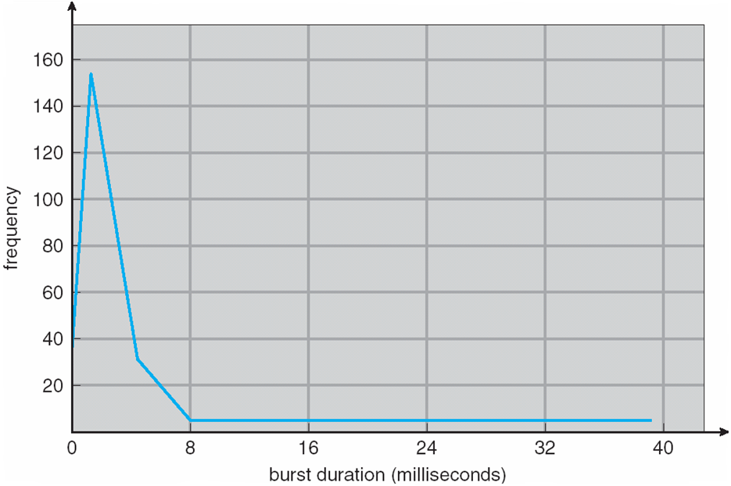
Histogram of CPU-burst Times

Slide 70
Dispatcher
Dispatcher module gives control of the CPU to the process selected by the short-term scheduler; this involves:
switching context
switching to user mode
jumping to the proper location in the user program to restart that program
Dispatch latency – time it takes for the dispatcher to stop one process and start another running

Slide 71
Scheduling Criteria
CPU utilization – keep the CPU as busy as possible
Throughput – # of processes that complete their execution per time unit
Turnaround time – amount of time to execute a particular process
Waiting time – amount of time a process has been waiting in the ready queue
Response time – amount of time it takes from when a request was submitted until the first response is produced, not output (for time-sharing environment)

Slide 72
Scheduling Algorithm Optimization Criteria
Max CPU utilization
Max throughput
Min turnaround time
Min waiting time
Min response time

Slide 73
First- Come, First-Served (FCFS) Scheduling
Process Burst Time
P₁ 24
P₂ 3
P₃ 3
Suppose that the processes arrive in the order: P₁ , P₂ , P₃ The Gantt Chart for the schedule is:
Waiting time for P₁ = 0; P₂ = 24; P₃ = 27
Average waiting time: (0 + 24 + 27)/3 = 17

Slide 74
FCFS Scheduling (Cont.)
Suppose that the processes arrive in the order:
P₂ , P₃ , P₁
The Gantt chart for the schedule is:
Waiting time for P₁ = 6; P₂ = 0; P₃ = 3
Average waiting time: (6 + 0 + 3)/3 = 3
Much better than previous case
Convoy effect - short process behind long process
Consider one CPU-bound and many I/O-bound processes

Slide 75
Shortest-Job-First (SJF) Scheduling
Associate with each process the length of its next CPU burst
Use these lengths to schedule the process with the shortest time
SJF is optimal – gives minimum average waiting time for a given set of processes
The difficulty is knowing the length of the next CPU request
Could ask the user

Slide 76
Example of SJF
ProcessArriva l Time Burst Time
P₁ 0.0 6
P₂ 2.0 8
P₃ 4.0 7
P₄ 5.0 3
SJF scheduling chart
Average waiting time = (3 + 16 + 9 + 0) / 4 = 7

Slide 77
Determining Length of Next CPU Burst
Can only estimate the length – should be similar to the previous one
Then pick process with shortest predicted next CPU burst
Can be done by using the length of previous CPU bursts, using exponential averaging
Commonly, α set to ½
Preemptive version called shortest-remaining-time-first

Slide 78
Prediction of the Length of the Next CPU Burst

Slide 79
Examples of Exponential Averaging
α =0
τ_{n+1} = τ_{n}
Recent history does not count
α =1
τ_{n+1} = α t_{n}
Only the actual last CPU burst counts
If we expand the formula, we get:
τ_{n+1} = α t_{n}+(1 - α)α t_{n} ₋₁ + …
+(1 - α )^{j} α t_{n} _{-j} + …
+(1 - α )^{n +1} τ₀
Since both α and (1 - α) are less than or equal to 1, each successive term has less weight than its predecessor

Slide 80
Example of Shortest-remaining-time-first
Now we add the concepts of varying arrival times and preemption to the analysis
ProcessA arri Arrival TimeT Burst Time
P₁ 0 8
P₂ 1 4
P₃ 2 9
P₄ 3 5
Preemptive SJF Gantt Chart
Average waiting time = [(10-1)+(1-1)+(17-2)+5-3)]/4 = 26/4 = 6.5 msec

Slide 81
Priority Scheduling
A priority number (integer) is associated with each process
The CPU is allocated to the process with the highest priority (smallest integer ≡ highest priority)
Preemptive
Nonpreemptive
SJF is priority scheduling where priority is the inverse of predicted next CPU burst time
Problem ≡ Starvation – low priority processes may never execute
Solution ≡ Aging – as time progresses increase the priority of the process

Slide 82
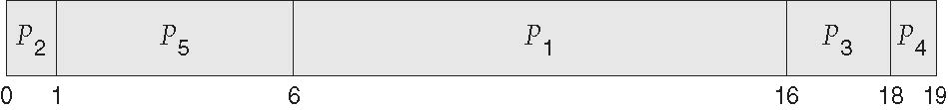
Example of Priority Scheduling
ProcessA arri Burst TimeT Priority
P₁ 10 3
P₂ 1 1
P₃ 2 4
P₄ 1 5
P₅ 5 2
Priority scheduling Gantt Chart
Average waiting time = 8.2 msec

Slide 83
Round Robin (RR)
Each process gets a small unit of CPU time (time quantum q), usually 10-100 milliseconds. After this time has elapsed, the process is preempted and added to the end of the ready queue.
If there are n processes in the ready queue and the time quantum is q, then each process gets 1/n of the CPU time in chunks of at most q time units at once. No process waits more than (n-1)q time units.
Timer interrupts every quantum to schedule next process
Performance
q large ⇒ FIFO
q small ⇒ q must be large with respect to context switch, otherwise overhead is too high

Slide 84
Example of RR with Time Quantum = 4
Process Burst Time
P₁ 24
P₂ 3
P₃ 3
The Gantt chart is:
Typically, higher average turnaround than SJF, but better response
q should be large compared to context switch time
q usually 10ms to 100ms, context switch < 10 usec

Slide 85
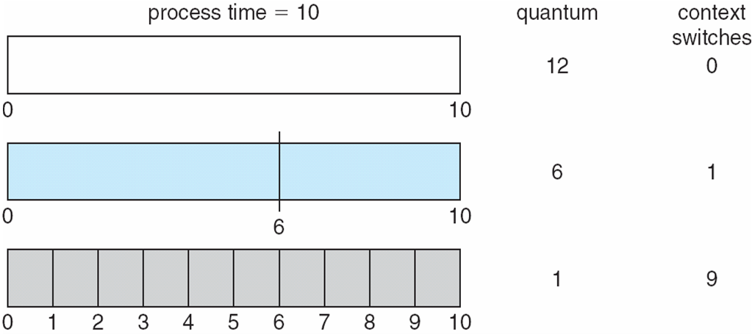
Time Quantum and Context Switch Time

Slide 86
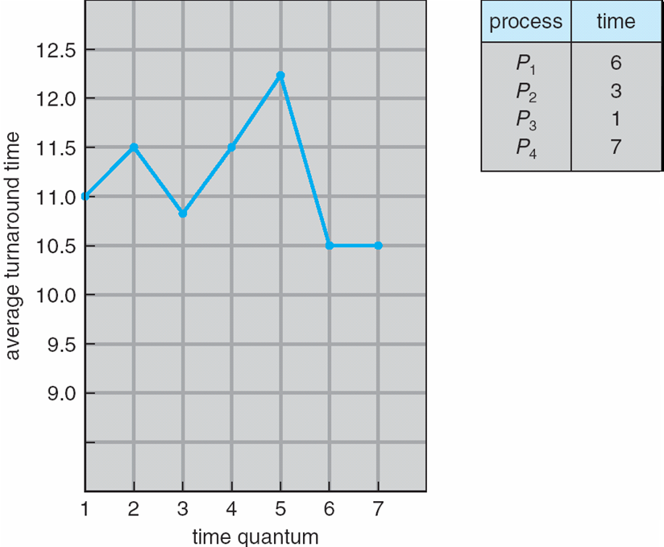
Turnaround Time Varies With The Time Quantum
80% of CPU bursts should be shorter than q

Slide 87
Multilevel Queue
Ready queue is partitioned into separate queues, eg:
foreground (interactive)
background (batch)
Process permanently in a given queue
Each queue has its own scheduling algorithm:
foreground – RR
background – FCFS
Scheduling must be done between the queues:
Fixed priority scheduling; (i.e., serve all from foreground then from background). Possibility of starvation.
Time slice – each queue gets a certain amount of CPU time which it can schedule amongst its processes; i.e., 80% to foreground in RR
20% to background in FCFS

Slide 88
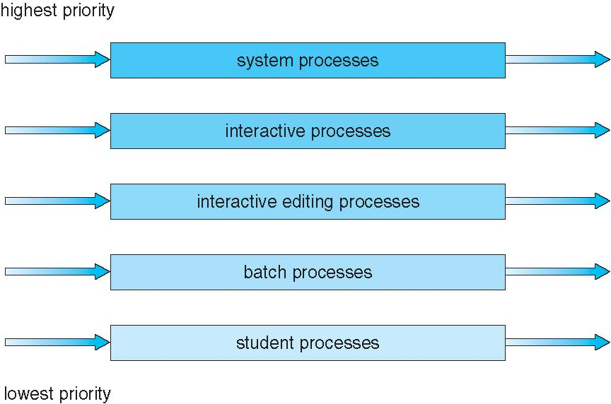
Multilevel Queue Scheduling

Slide 89
Multilevel Feedback Queue
A process can move between the various queues; aging can be implemented this way
Multilevel-feedback-queue scheduler defined by the following parameters:
number of queues
scheduling algorithms for each queue
method used to determine when to upgrade a process
method used to determine when to demote a process
method used to determine which queue a process will enter when that process needs service

Slide 90
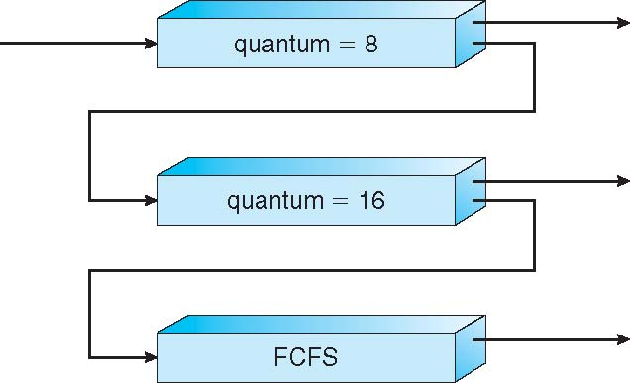
Example of Multilevel Feedback Queue
Three queues:
Q₀ – RR with time quantum 8 milliseconds
Q₁ – RR time quantum 16 milliseconds
Q₂ – FCFS
Scheduling
A new job enters queue Q₀ which is served FCFS
When it gains CPU, job receives 8 milliseconds
If it does not finish in 8 milliseconds, job is moved to queue Q₁
At Q₁ job is again served FCFS and receives 16 additional milliseconds
If it still does not complete, it is preempted and moved to queue Q₂

Slide 91
Preemptive vs Non-Preemptive Scheduling
Short-term scheduler selects from among the processes in ready queue, and allocates the CPU to one of them
Queue may be ordered in various ways
CPU scheduling decisions may take place when a process:
1. Switches from running to waiting state
2. Switches from running to ready state
3. Switches from waiting to ready
Terminates
Scheduling under 1 and 4 is nonpreemptive
All other scheduling is preemptive
Consider access to shared data
Consider preemption while in kernel mode
Consider interrupts occurring during crucial OS activities

Slide 92
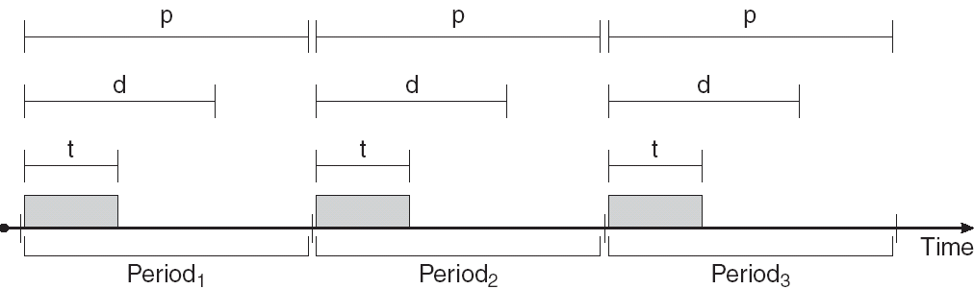
Real-Time CPU Scheduling
Periodic processes require the CPU at specified intervals (periods)
p is the duration of the period
d is the deadline by when the process must be serviced
t is the processing time

Slide 93
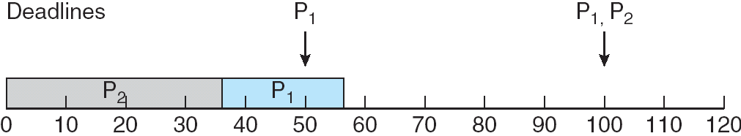
Scheduling of tasks when P2 has a higher priority than P1

Slide 94
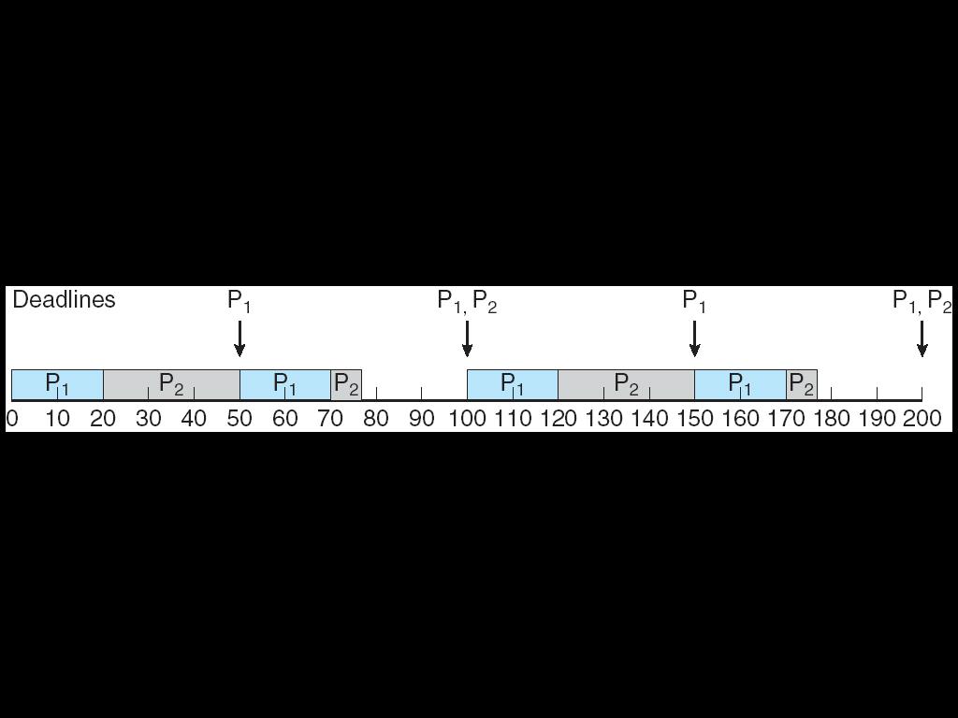
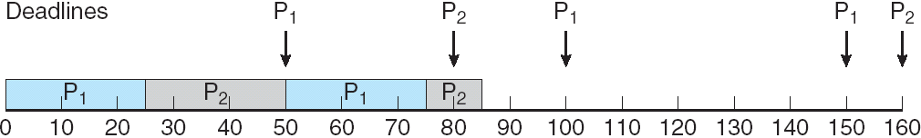
Rate Monotonic (RM) Scheduling
A priority is assigned based on the inverse of its period
Shorter periods = higher priority;
Longer periods = lower priority
P1 is assigned a higher priority than P2.
Missed Deadlines with Rate Monotonic Scheduling

Slide 95
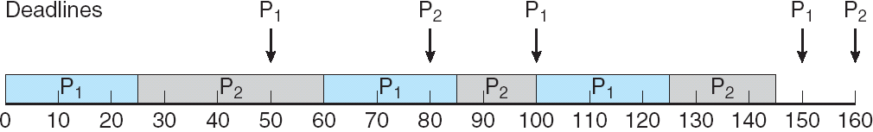
Earliest Deadline First Scheduling
Priorities are assigned according to deadlines:
the earlier the deadline, the higher the priority;
the later the deadline, the lower the priority.
P1 has values of p1 = 50 and t1 = 25 and that P2 has values of p2 = 80 and t2 = 35.
The EDF scheduling of these processes is shown in Figure.
Process P1 has the earliest deadline, so its initial priority is higher than that of process P2.
Process P2 begins running at the end of the CPU burst for P1.

Slide 96
Earliest Deadline First Scheduling
Unlike the rate-monotonic algorithm, EDF scheduling does not require that processes be periodic, nor must a process require a constant amount of CPU time per burst.
The only requirement is that a process announce its deadline to the scheduler when it becomes runnable.

Slide 97
Deadlock

Slide 98
Deadlock
Necessary conditions,
Resource allocation graph,
Deadlock prevention methods
Deadlock Avoidance,
Detection and Recovery

Slide 99
DeadLocks - System Model
System consists of resources
Resource types R₁, R₂, . . ., R_{m}
CPU cycles, memory space, I/O devices
Each resource type R_{i} has W_{i} instances.
Each process utilizes a resource as follows:
request
use
release

Slide 100
Deadlock Characterization
Deadlock can arise if four conditions hold simultaneously.
Mutual exclusion: only one process at a time can use a resource
Hold and wait: a process holding at least one resource is waiting to acquire additional resources held by other processes
No preemption: a resource can be released only voluntarily by the process holding it, after that process has completed its task
Circular wait: there exists a set {P₀, P₁, …, P_{n}} of waiting processes such that P₀ is waiting for a resource that is held by P₁, P₁ is waiting for a resource that is held by P₂, …, P_{n–1} is waiting for a resource that is held by P_{n}, and P_{n} is waiting for a resource that is held by P₀.

Slide 101
Deadlock with Mutex Locks
Deadlocks can occur via system calls, locking, etc.
See example box in text page 318 for mutex deadlock

Slide 102
Resource-Allocation Graph
A set of vertices V and a set of edges E.
V is partitioned into two types:
P = {P₁, P₂, …, P_{n}}, the set consisting of all the processes in the system
R = {R₁, R₂, …, R_{m}}, the set consisting of all resource types in the system
request edge – directed edge P_{i} → R_{j}
assignment edge – directed edge R_{j} → P_{i}

Slide 103
Resource-Allocation Graph (Cont.)
Process
Resource Type with 4 instances
P_{i} requests instance of R_{j}
P_{i} is holding an instance of R_{j}
P_{i}
P_{i}

Slide 104
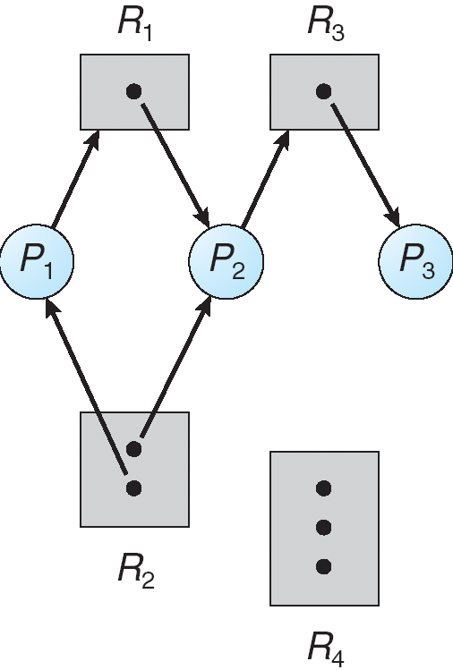
Example of a Resource Allocation Graph

Slide 105
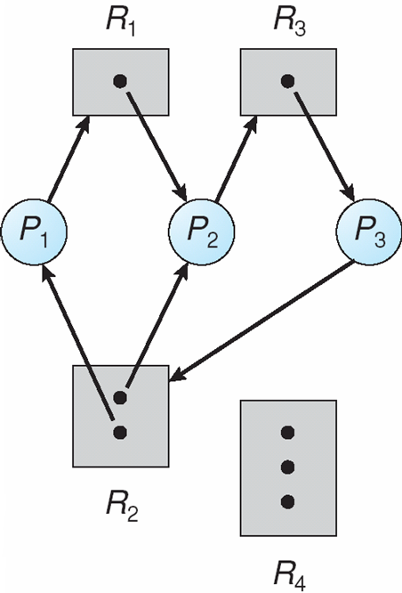
Resource Allocation Graph With A Deadlock

Slide 106
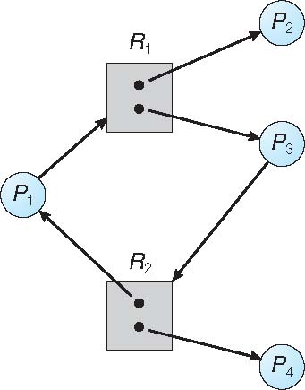
Graph With A Cycle But No Deadlock

Slide 107
Basic Facts
If graph contains no cycles ⇒ no deadlock
If graph contains a cycle ⇒
if only one instance per resource type, then deadlock
if several instances per resource type, possibility of deadlock

Slide 108
Methods for Handling Deadlocks
Ensure that the system will never enter a deadlock state:
Deadlock prevention
Deadlock avoidence
Allow the system to enter a deadlock state and then recover
Ignore the problem and pretend that deadlocks never occur in the system; used by most operating systems, including UNIX

Slide 109
Deadlock Prevention
Restrain the ways request can be made
Mutual Exclusion – not required for sharable resources (e.g., read-only files); must hold for non-sharable resources
Hold and Wait – must guarantee that whenever a process requests a resource, it does not hold any other resources
Require process to request and be allocated all its resources before it begins execution, or allow process to request resources only when the process has none allocated to it.
Low resource utilization; starvation possible

Slide 110
Deadlock Prevention (Cont.)
No Preemption –
If a process that is holding some resources requests another resource that cannot be immediately allocated to it, then all resources currently being held are released
Preempted resources are added to the list of resources for which the process is waiting
Process will be restarted only when it can regain its old resources, as well as the new ones that it is requesting
Circular Wait – impose a total ordering of all resource types, and require that each process requests resources in an increasing order of enumeration

Slide 111
Deadlock Example
/* thread one runs in this function */
void *do_work_one(void *param) {
pthread_mutex_lock(&first_mutex);
pthread_mutex_lock(&second_mutex);
/** * Do some work */ pthread_mutex_unlock(&second_mutex);
pthread_mutex_unlock(&first_mutex);
pthread_exit(0);
}
/* thread two runs in this function */
void *do_work_two(void *param) {
pthread_mutex_lock(&second_mutex);
pthread_mutex_lock(&first_mutex);
/** * Do some work */ pthread_mutex_unlock(&first_mutex);
pthread_mutex_unlock(&second_mutex);
pthread_exit(0);
}

Slide 112
Deadlock Example with Lock Ordering
void transaction(Account from, Account to, double amount)
{
mutex lock1, lock2;
lock1 = get_lock(from);
lock2 = get_lock(to);
acquire(lock1);
acquire(lock2);
withdraw(from, amount);
deposit(to, amount);
release(lock2);
release(lock1);
}
Transactions 1 and 2 execute concurrently. Transaction 1 transfers $25 from account A to account B, and Transaction 2 transfers $50 from account B to account A

Slide 113
Deadlock Avoidance
Requires that the system has some additional a priori information available
Simplest and most useful model requires that each process declare the maximum number of resources of each type that it may need
The deadlock-avoidance algorithm dynamically examines the resource-allocation state to ensure that there can never be a circular-wait condition
Resource-allocation state is defined by the number of available and allocated resources, and the maximum demands of the processes

Slide 114
Safe State
When a process requests an available resource, system must decide if immediate allocation leaves the system in a safe state
System is in safe state if there exists a sequence <P₁, P₂, …, P_{n}> of ALL the processes in the systems such that for each P_{i}, the resources that P_{i} can still request can be satisfied by currently available resources + resources held by all the P_{j}, with j < I
That is:
If P_{i} resource needs are not immediately available, then P_{i} can wait until all P_{j} have finished
When P_{j} is finished, P_{i} can obtain needed resources, execute, return allocated resources, and terminate
When P_{i} terminates, P_{i +1} can obtain its needed resources, and so on

Slide 115
Basic Facts
If a system is in safe state ⇒ no deadlocks
If a system is in unsafe state ⇒ possibility of deadlock
Avoidance ⇒ ensure that a system will never enter an unsafe state.

Slide 116
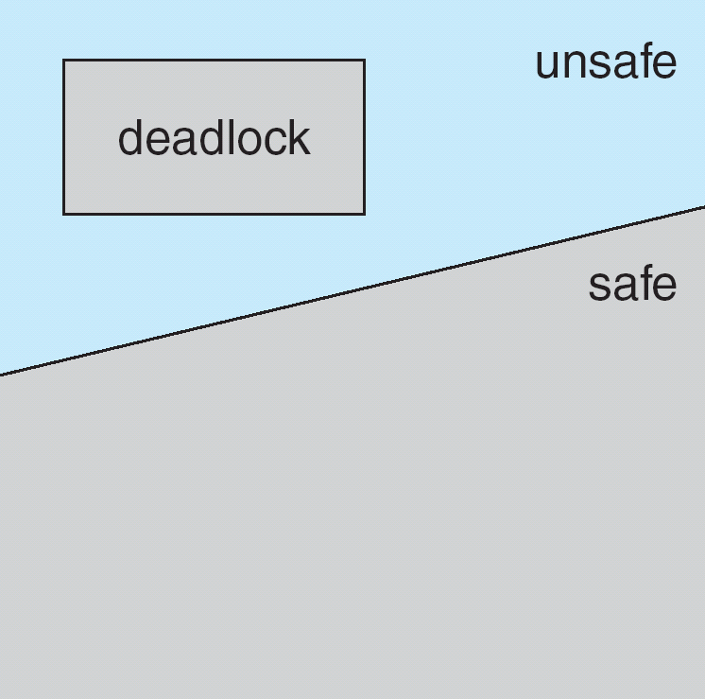
Safe, Unsafe, Deadlock State

Slide 117
Avoidance Algorithms
Single instance of a resource type
Use a resource-allocation graph
Multiple instances of a resource type
Use the banker’s algorithm

Slide 118
Resource-Allocation Graph Scheme
Claim edge P_{i} → R_{j} indicated that process P_{j} may request resource R_{j}; represented by a dashed line
Claim edge converts to request edge when a process requests a resource
Request edge converted to an assignment edge when the resource is allocated to the process
When a resource is released by a process, assignment edge reconverts to a claim edge
Resources must be claimed a priori in the system

Slide 119
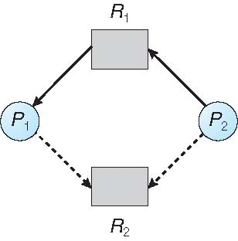
Resource-Allocation Graph

Slide 120
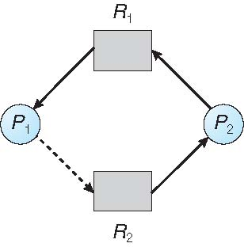
Unsafe State In Resource-Allocation Graph

Slide 121
Resource-Allocation Graph Algorithm
Suppose that process P_{i} requests a resource R_{j}
The request can be granted only if converting the request edge to an assignment edge does not result in the formation of a cycle in the resource allocation graph

Slide 122
Banker’s Algorithm
Multiple instances
Each process must a priori claim maximum use
When a process requests a resource it may have to wait
When a process gets all its resources it must return them in a finite amount of time

Slide 123
Data Structures for the Banker’s Algorithm
Let n = number of processes, and m = number of resources types.
Available: Vector of length m. If available [j] = k, there are k instances of resource type R_{j} available
Max: n x m matrix. If Max [i,j] = k, then process P_{i} may request at most k instances of resource type R_{j}
Allocation: n x m matrix. If Allocation[i,j] = k then P_{i} is currently allocated k instances of R_{j}
Need: n x m matrix. If Need[i,j] = k, then P_{i} may need k more instances of R_{j} to complete its task
Need [i,j] = Max[i,j] – Allocation [i,j]

Slide 124
Safety Algorithm
1. Let Work and Finish be vectors of length m and n, respectively. Initialize:
Work = Available
Finish [i] = false for i = 0, 1, …, n- 1
2. Find an i such that both:
(a) Finish [i] = false
(b) Need_{i} ≤ Work
If no such i exists, go to step 4
3. Work = Work + Allocation_{i} Finish[i] = true go to step 2
4. If Finish [i] == true for all i, then the system is in a safe state

Slide 125
Resource-Request Algorithm for Process P_{i}
Request_{i} = request vector for process P_{i}. If Request_{i} [j] = k then process P_{i} wants k instances of resource type R_{j}
1. If Request_{i} ≤ Need_{i} go to step 2. Otherwise, raise error condition, since process has exceeded its maximum claim
2. If Request_{i} ≤ Available, go to step 3. Otherwise P_{i} must wait, since resources are not available
3. Pretend to allocate requested resources to P_{i} by modifying the state as follows:
Available = Available – Request_{i};
Allocation_{i} = Allocation_{i} + Request_{i};
Need_{i} = Need_{i} – Request_{i};
If safe ⇒ the resources are allocated to P_{i}
If unsafe ⇒ P_{i} must wait, and the old resource-allocation state is restored

Slide 126
Example of Banker’s Algorithm
5 processes P₀ through P₄;
3 resource types:
A (10 instances), B (5instances), and C (7 instances)
Snapshot at time T₀:
Allocation Max Available
A B C A B C A B C
P₀ 0 1 0 7 5 3 3 3 2
P₁ 2 0 0 3 2 2
P₂ 3 0 2 9 0 2
P₃ 2 1 1 2 2 2
P₄ 0 0 2 4 3 3

Slide 127
Example (Cont.)
The content of the matrix Need is defined to be Max – Allocation
Need
A B C
P₀ 7 4 3
P₁ 1 2 2
P₂ 6 0 0
P₃ 0 1 1
P₄ 4 3 1
The system is in a safe state since the sequence < P₁, P₃, P₄, P₂, P₀> satisfies safety criteria

Slide 128
Example: P₁ Request (1,0,2)
Check that Request ≤ Available (that is, (1,0,2) ≤ (3,3,2) ⇒ true
Allocation Need Available
A B C A B C A B C
P₀ 0 1 0 7 4 3 2 3 0
P₁ 3 0 2 0 2 0
P₂ 3 0 2 6 0 0
P₃ 2 1 1 0 1 1
P₄ 0 0 2 4 3 1
Executing safety algorithm shows that sequence < P₁, P₃, P₄, P₀, P₂> satisfies safety requirement
Can request for (3,3,0) by P₄ be granted?
Can request for (0,2,0) by P₀ be granted?

Slide 129
Deadlock Detection
Allow system to enter deadlock state
Detection algorithm
Recovery scheme

Slide 130
Single Instance of Each Resource Type
Maintain wait-for graph
Nodes are processes
P_{i} → P_{j} if P_{i} is waiting for P_{j}
Periodically invoke an algorithm that searches for a cycle in the graph. If there is a cycle, there exists a deadlock
An algorithm to detect a cycle in a graph requires an order of n² operations, where n is the number of vertices in the graph

Slide 131
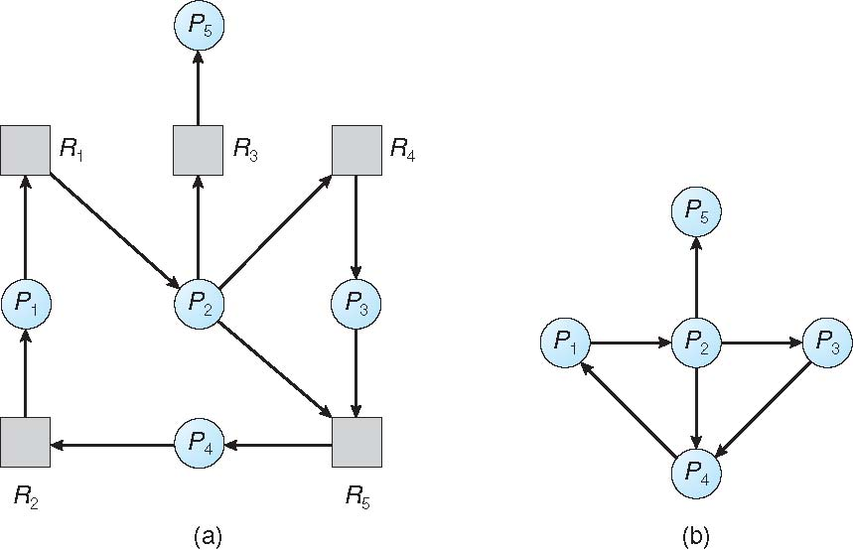
Resource-Allocation Graph and Wait-for Graph

Slide 132
Several Instances of a Resource Type
Available: A vector of length m indicates the number of available resources of each type
Allocation: An n x m matrix defines the number of resources of each type currently allocated to each process
Request: An n x m matrix indicates the current request of each process. If Request [i][j] = k, then process P_{i} is requesting k more instances of resource type R_{j}.

Slide 133
Detection Algorithm
1. Let Work and Finish be vectors of length m and n, respectively Initialize:
(a) Work = Available
(b) For i = 1,2, …, n, if Allocation_{i} ≠ 0, then Finish[i] = false; otherwise, Finish[i] = true
2. Find an index i such that both:
(a) Finish[i] == false
(b) Request_{i} ≤ Work
If no such i exists, go to step 4

Slide 134
Detection Algorithm (Cont.)
3. Work = Work + Allocation_{i} Finish[i] = true go to step 2
4. If Finish[i] == false, for some i, 1 ≤ i ≤ n, then the system is in deadlock state. Moreover, if Finish[i] == false, then P_{i} is deadlocked
Algorithm requires an order of O(m x n²) operations to detect whether the system is in deadlocked state

Slide 135
Example of Detection Algorithm
Five processes P₀ through P₄; three resource types A (7 instances), B (2 instances), and C (6 instances)
Snapshot at time T₀:
Allocation Request Available
A B C A B C A B C
P₀ 0 1 0 0 0 0 0 0 0
P₁ 2 0 0 2 0 2
P₂ 3 0 3 0 0 0
P₃ 2 1 1 1 0 0
P₄ 0 0 2 0 0 2
Sequence <P₀, P₂, P₃, P₁, P₄> will result in Finish[i] = true for all i

Slide 136
Example (Cont.)
P₂ requests an additional instance of type C
Request
A B C
P₀ 0 0 0
P₁ 2 0 2
P₂ 0 0 1
P₃ 1 0 0
P₄ 0 0 2
State of system?
Can reclaim resources held by process P₀, but insufficient resources to fulfill other processes; requests
Deadlock exists, consisting of processes P₁, P₂, P₃, and P₄

Slide 137
Detection-Algorithm Usage
When, and how often, to invoke depends on:
How often a deadlock is likely to occur?
How many processes will need to be rolled back?
one for each disjoint cycle
If detection algorithm is invoked arbitrarily, there may be many cycles in the resource graph and so we would not be able to tell which of the many deadlocked processes “caused” the deadlock.

Slide 138
Recovery from Deadlock: Process Termination
Abort all deadlocked processes
Abort one process at a time until the deadlock cycle is eliminated
In which order should we choose to abort?
Priority of the process
How long process has computed, and how much longer to completion
Resources the process has used
Resources process needs to complete
How many processes will need to be terminated
Is process interactive or batch?

Slide 139
Recovery from Deadlock: Resource Preemption
Selecting a victim – minimize cost
Rollback – return to some safe state, restart process for that state
Starvation – same process may always be picked as victim, include number of rollback in cost factor

